Slide 1

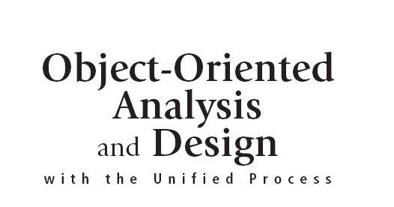


Slide 2
Objectives
Describe the differences and similarities between relational and object-oriented database management systems
Design an object database schema based on a class diagram
Design a relational database schema based on a class diagram
Object-Oriented Analysis and Design with the Unified Process

Slide 3
Objectives (continued)
Describe object-oriented design issues, including data access classes and data types
Describe the different architectural models for distributed databases
Determine when and how to design the database
Object-Oriented Analysis and Design with the Unified Process

Slide 4
Overview
Databases provide a common repository for data
Database management systems provide sophisticated capabilities to store, retrieve, and manage data
Detailed database models are derived from domain class diagrams
Database models are implemented using database management systems
Databases can be relational or OO models
Object-Oriented Analysis and Design with the Unified Process

Slide 5
Databases and Database Management Systems
A database is an integrated collection of stored data that is centrally managed and controlled
  Class attributes
  Associations
  Descriptive information about data and access controls
A DBMS is a system software component that manages and controls access to the database
  Ex. - Oracle, Gemstone, ObjectStore, Access, DB2
Object-Oriented Analysis and Design with the Unified Process

Slide 6
DBMS Components
Database
  Physical data store
    Raw bit and bytes of the database
  Schema
    Access and data controls, associations among attributes, details of physical data store
DBMS
  Interfaces to access schema and extract information for valid requests
  Data access programs and subroutines (instructions that perform a specific task, packaged as a unit)
Object-Oriented Analysis and Design with the Unified Process

Slide 7
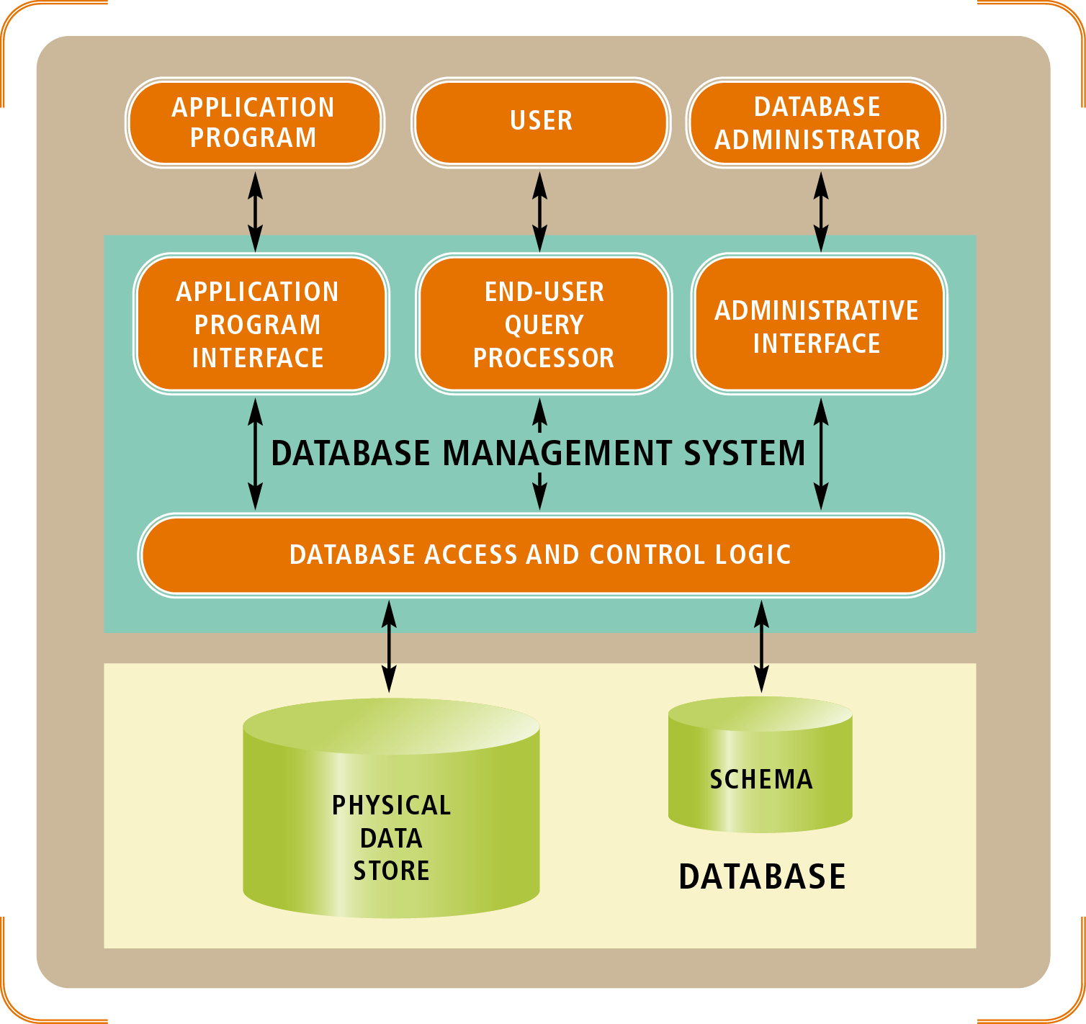
Figure 10-1
The components of a database and a database management system and their interaction with application programs, users, and database administrators
Object-Oriented Analysis and Design with the Unified Process

Slide 8
Database Models
Database models have evolved since their introduction in the 1960s
  Hierarchical
  Network
  Relational
  Object-oriented
Most existing and newly developed systems use the relational or object-oriented approach
Object-Oriented Analysis and Design with the Unified Process

Slide 9
Object-Oriented Databases
Object Database Management System (ODBMS)
  Stores data as objects
  Prototypes introduced in 1980s
  Technology of choice for newly designed systems
Object Definition Language (ODL)
  Standard developed by the ODMG for defining the structure and content of an object database
Java Data Objects (JDO)
  Java-specific object database standard
Object-Oriented Analysis and Design with the Unified Process

Slide 10
Designing Object Databases
Determine which classes require persistent storage
Represent persistent classes
Represent associations among persistent classes
Choose appropriate data types and value restrictions (if necessary) for each field
Object-Oriented Analysis and Design with the Unified Process

Slide 11
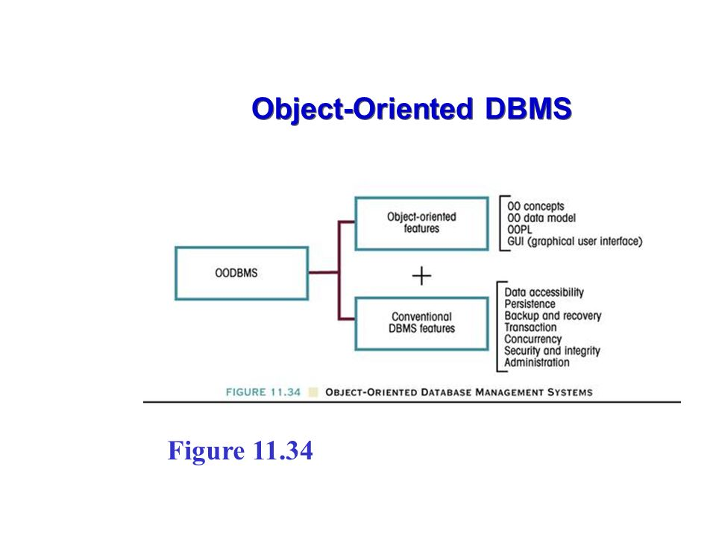

Object-Oriented Analysis and Design with the Unified Process

Slide 12
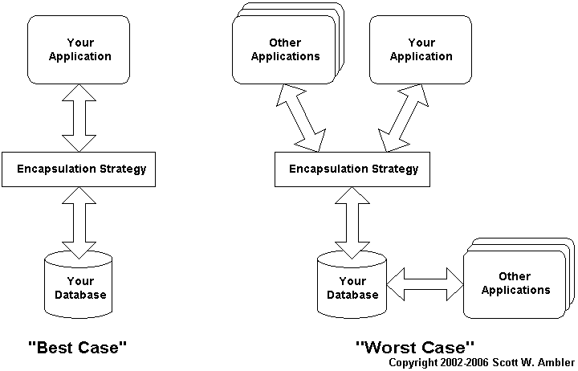
Object-Oriented Analysis and Design with the Unified Process

Slide 13
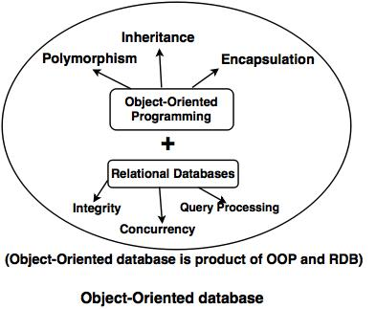
Object-Oriented Analysis and Design with the Unified Process

Slide 14
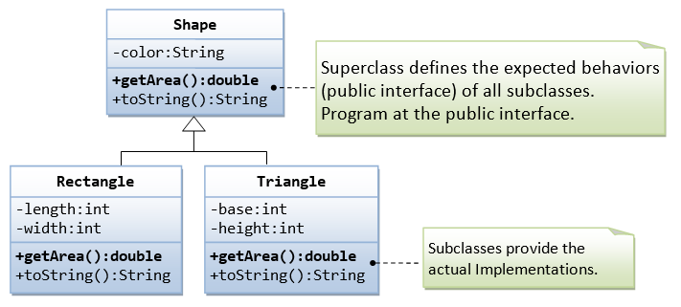
In object-oriented programming, polymorphism refers to a programming language's ability to process objects differently depending on their data type or class. More specifically, it is the ability to redefine methods for derived classes.
Object-Oriented Analysis and Design with the Unified Process

Slide 15
Representing Classes
An object database schema requires a class definition for each persistent class
  ODL class definitions derive from the domain model class diagram
    Class Customer {
    attribute string accountNo
    attribute string name
    attribute string billingAddress
    attribute string shippingAddress
    attribute string dayTelephoneNumber
    attribute string nightTelephoneNumber
    }
Object-Oriented Analysis and Design with the Unified Process

Slide 16
Representing Associations
ODBMSs represent associations by storing the object identifier of one object within related objects
  Use attributes with object identifiers to find related objects (called navigation)
Designers represent associations indirectly by declaring associations between objects
  Use keywords relationship and inverse
  ODBMS automatically creates object identifiers for declared associations
Object-Oriented Analysis and Design with the Unified Process

Slide 17
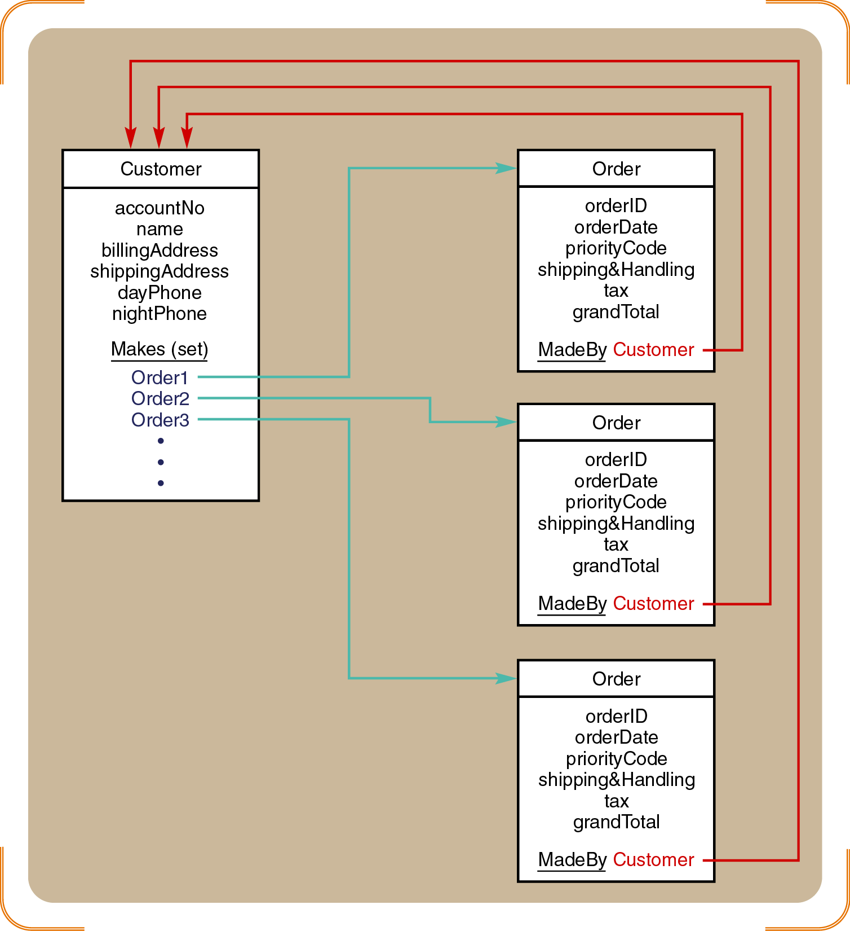
Figure 10-5
A one-to-many association represented with attributes containing object identifiers
Object-Oriented Analysis and Design with the Unified Process

Slide 18
One-to-Many Relationships
Partial ODL class definition
    Class Customer {
    attribute string accountNo
    …
    relationship set<Order> Makes
    inverse Order::MadeBy
    }
    Class Order {
    attribute string orderID
    …
    relationship Order MadeBy
    inverse Customer::Makes
    }
Object-Oriented Analysis and Design with the Unified Process

Slide 19
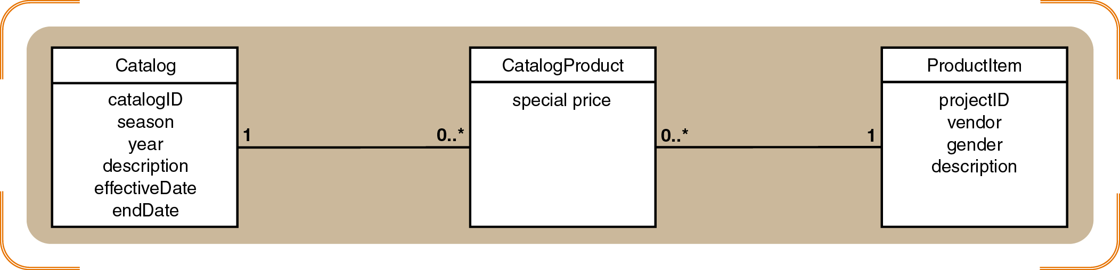
Figure 10-7
A many-to-many association represented with
two one-to-many associations
Object-Oriented Analysis and Design with the Unified Process

Slide 20
Many-to-Many Relationships
ODL uses multivalued attributes and an association class
    Class Catalog {
    …
    relationship set<CatalogProduct> Contains1
    inverse CatalogProduct::AppearsIn1
    }
    Class ProductItem {
    …
    relationship set<CatalogProduct> AppearsIn2
    inverse CatalogProduct::Contains2
    }
    Class CatalogProduct {
    attribute real specialPrice
    …
    relationship Catalog AppearsIn1
    inverse Catalog::Contains1
    relationship ProductItem AppearsIn2
    inverse ProductItem::Contains2
    }
Object-Oriented Analysis and Design with the Unified Process

Slide 21
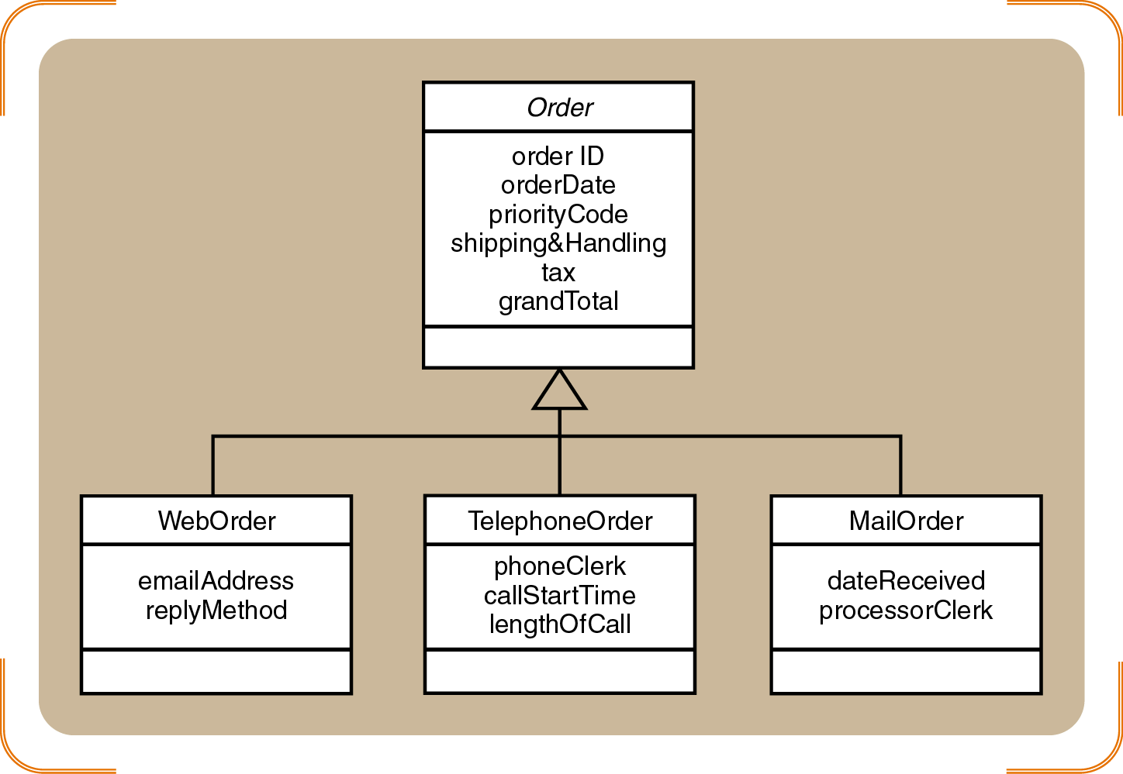
Figure 10-8
A generalization hierarchy within the RMO class diagram
Object-Oriented Analysis and Design with the Unified Process

Slide 22
Generalization Associations
ODL uses keyword extends
    Class Order {
    attribute string orderID
    …
    }
    Class WebOrder extends Order {
    attribute string emailAddress
    …
    }
    Class TelephoneOrder extends Order {
    attribute string phoneClerk
    …
    }
    …
Object-Oriented Analysis and Design with the Unified Process

Slide 23
Relational Databases
Organized data into structures called tables
  Tables contain rows (records) and columns (attributes)
Keys are the basis for representing relationship among tables
  Each table must have a unique key
  A primary key uniquely identifies a row in a table
  A foreign key duplicates the primary key in another table
  Keys may be natural or invented
Object-Oriented Analysis and Design with the Unified Process

Slide 24
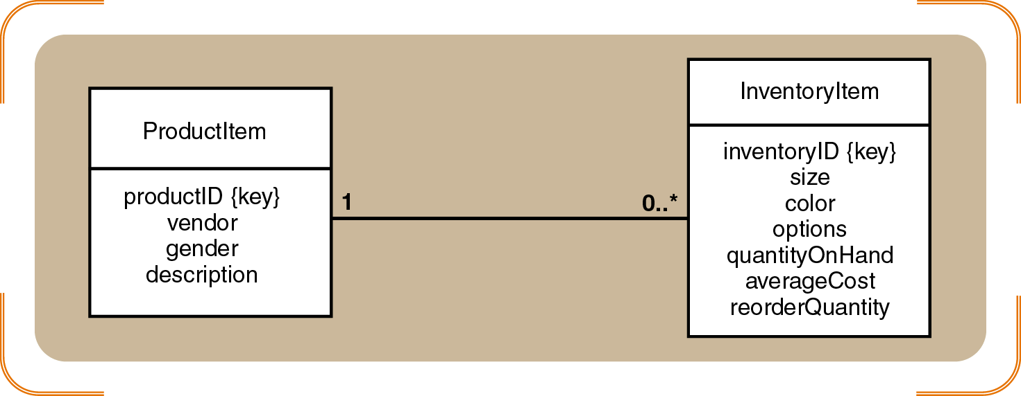
Figure 10-10
A portion of the RMO class diagram
Object-Oriented Analysis and Design with the Unified Process

Slide 25
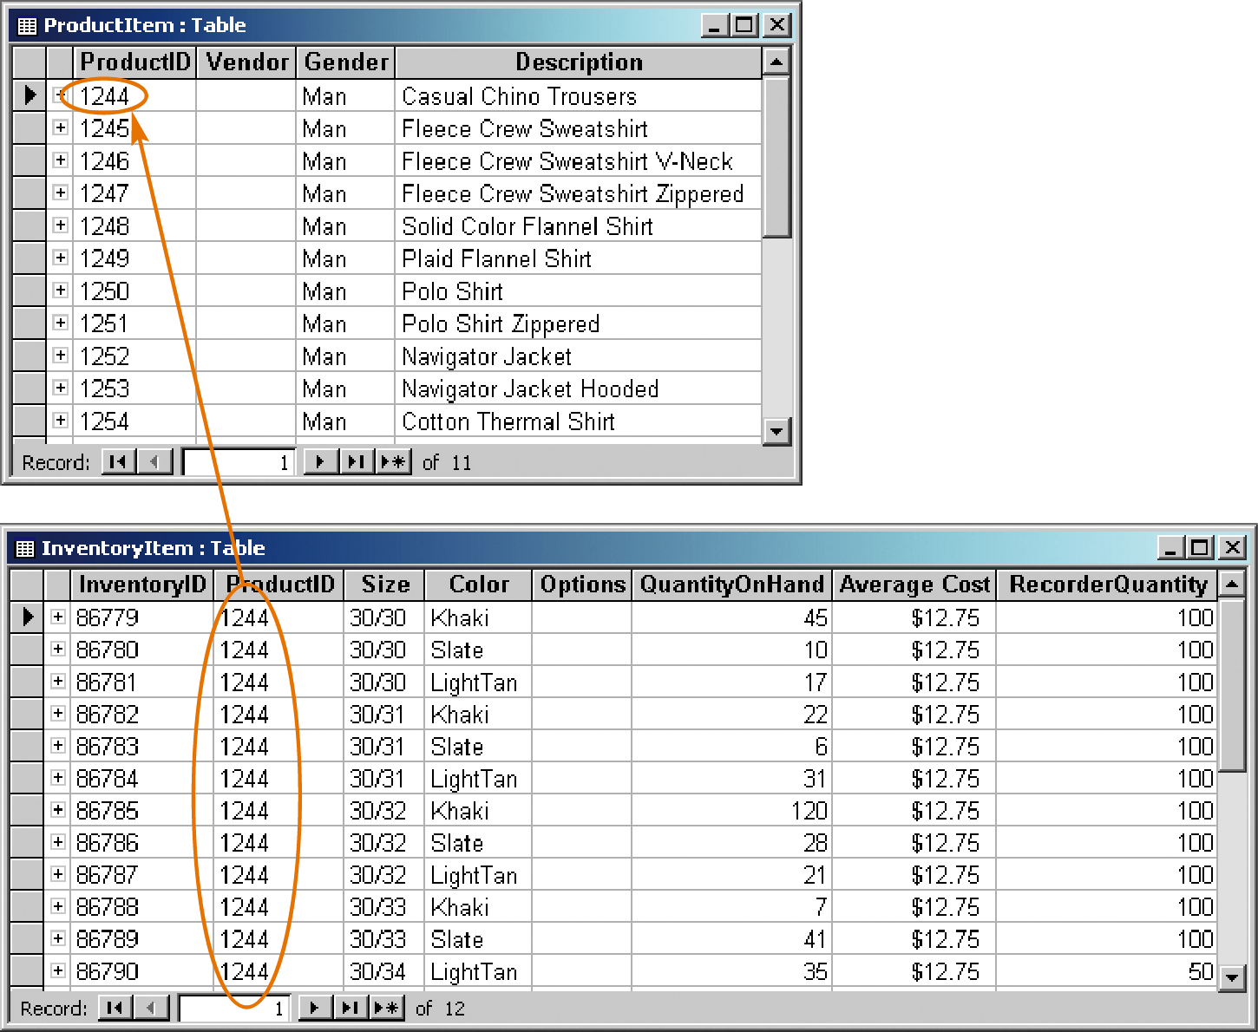
Figure 10-11
An association between data in two tables; the foreign key ProductID in the InventoryItem refers to the primary key ProductID in the ProductItem table.
Object-Oriented Analysis and Design with the Unified Process

Slide 26
Designing Relational Databases
Steps to create a relational schema from a class diagram
  Create a table for each class
  Choose a primary key for each table (invent one, if necessary)
  Add foreign keys to represent one-to-many relationships
  Create new tables to represent many-to-many relationships
Object-Oriented Analysis and Design with the Unified Process

Slide 27
Designing Relational Databases (continued)
  Represent classification hierarchies
  Define referential integrity constraints
  Evaluate schema quality and make necessary improvements
  Choose appropriate data types and value restrictions (if necessary) for each field
Object-Oriented Analysis and Design with the Unified Process

Slide 28
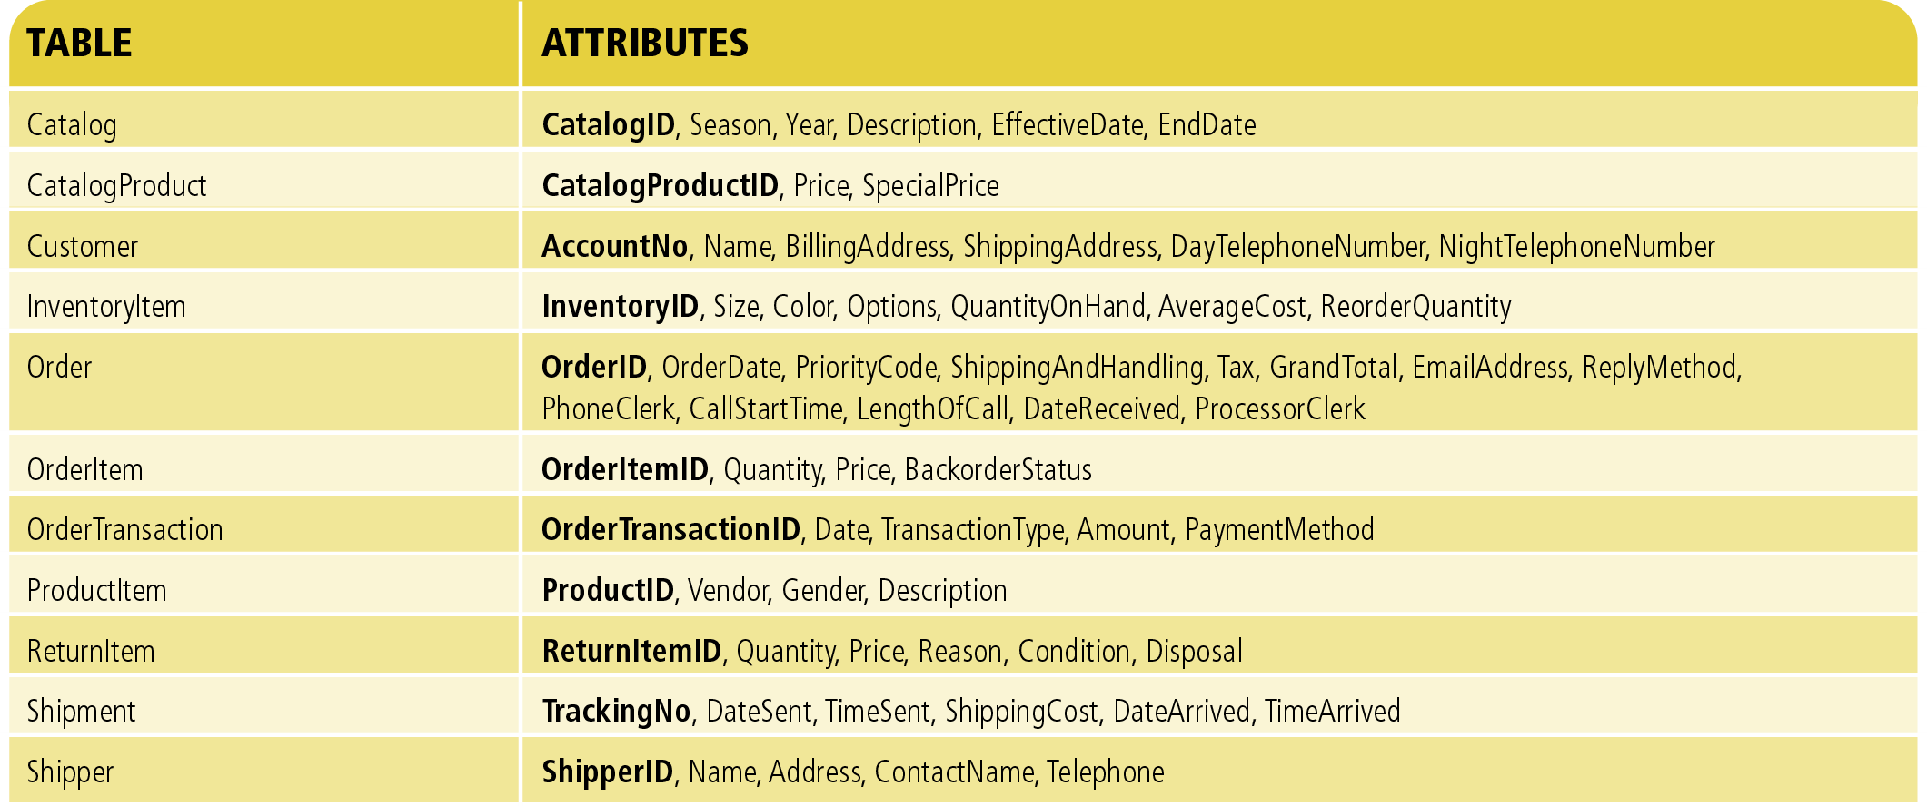
Figure 10-13
Class tables with primary keys identified in bold
Object-Oriented Analysis and Design with the Unified Process

Slide 29
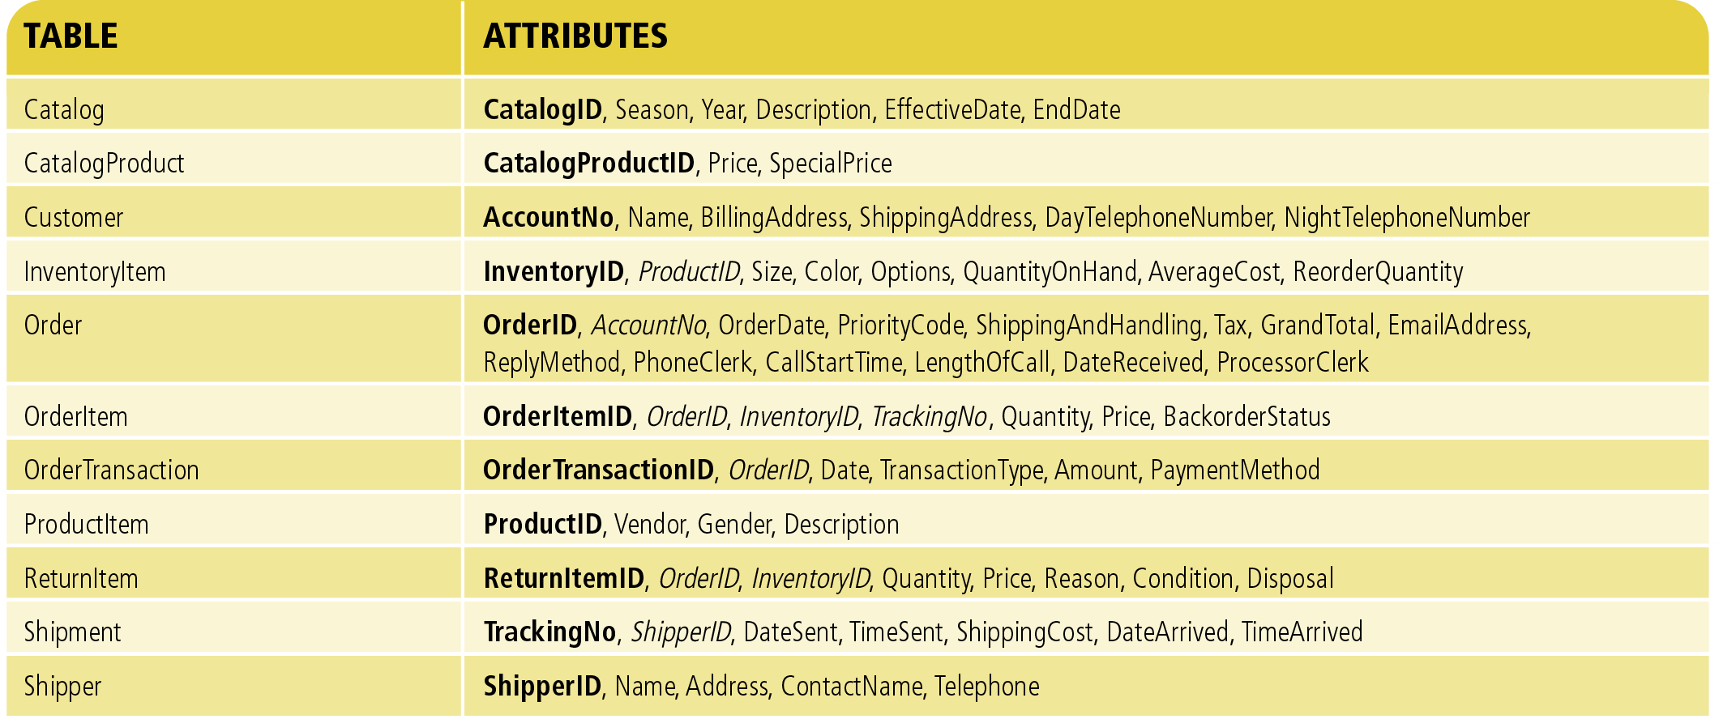
Figure 10-14
Represent one-to-many associations by adding
foreign key attributes (shown in italics)
Object-Oriented Analysis and Design with the Unified Process

Slide 30

Figure 10-15
The table CatalogProduct is modified to represent the many-to-many association between Catalog and ProductItem
Object-Oriented Analysis and Design with the Unified Process

Slide 31
Classification Hierarchies
Two approaches to represent hierarchies among tables
  Combine all tables into a single table containing the superset of all class attributes but excluding invented keys of the child classes
    See the Order class in Figure 10-15
  Use separate tables to represent the child classes, and use the primary key of the parent class table as the primary key of the child class tables
    See Figure 10-16
Object-Oriented Analysis and Design with the Unified Process

Slide 32
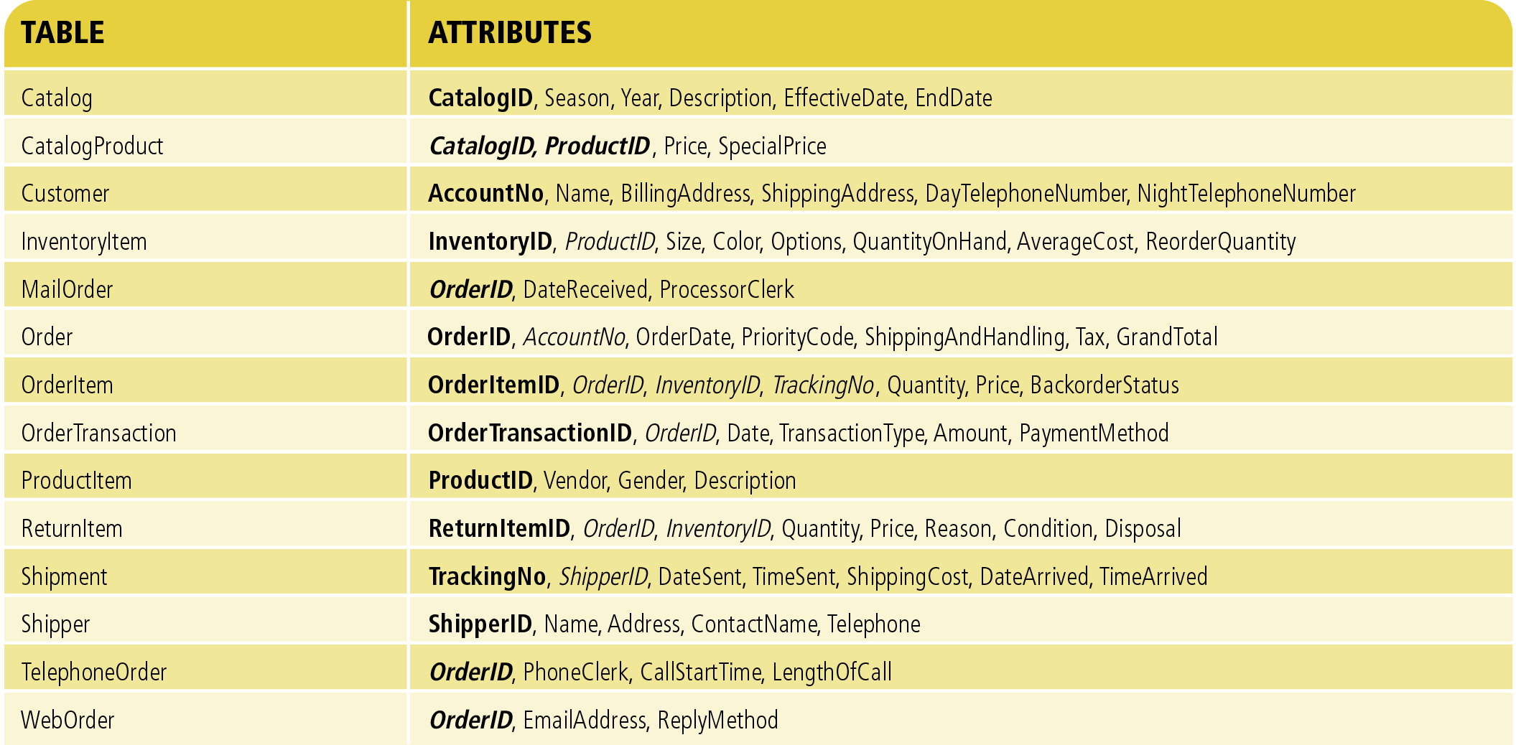
Figure 10-16
Specialized classes of Order are represented as separate tables with OrderID as both primary and foreign key
Object-Oriented Analysis and Design with the Unified Process

Slide 33
Enforcing Referential Integrity
Every foreign key must also exist as a primary key value
The DBMS usually automatically enforces referential integrity after the designer has identified primary and foreign keys
  Any new row containing an unknown foreign key value is rejected
  If a primary key is deleted or modified, the DBMS can be instructed to set all corresponding foreign keys to NULL
Object-Oriented Analysis and Design with the Unified Process

Slide 34
Evaluating Schema Quality
A high-quality data model has:
  Uniqueness of table rows and primary keys
    Use internally invented keys
  Lack of redundant data
    Non-key attributes are stored only once
  Ease of implementing future data model changes
    New associations only require adding a foreign key (one-to-one) or a new table (many-to-many)
Object-Oriented Analysis and Design with the Unified Process

Slide 35
Database Normalization
Normalization is a technique to ensure database schema quality by minimizing redundancy
  First normal form: no repeating attributes or groups of attributes in a table
  Functional dependency: a one-to-one correspondence between two attribute values
  Second normal form: every non-key attribute is functionally dependent on the primary key
  Third normal form: no non-key attribute is functionally dependent on any non-key attribute
Object-Oriented Analysis and Design with the Unified Process

Slide 36
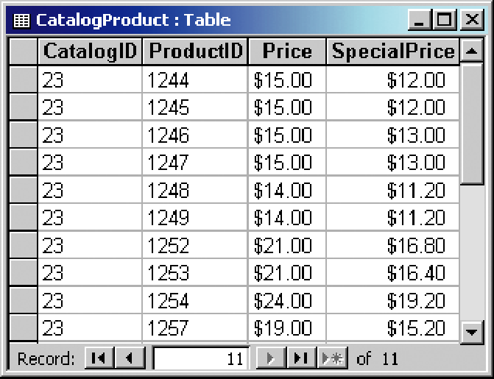
The primary key of CatalogProduct is the combination of CatalogID and ProductID, but CatalogIssueDate is only functionally dependent on CatalogID. This table is not in 2NF.
Figure 10-18
A simplified RMO CatalogProduct table
Object-Oriented Analysis and Design with the Unified Process

Slide 37
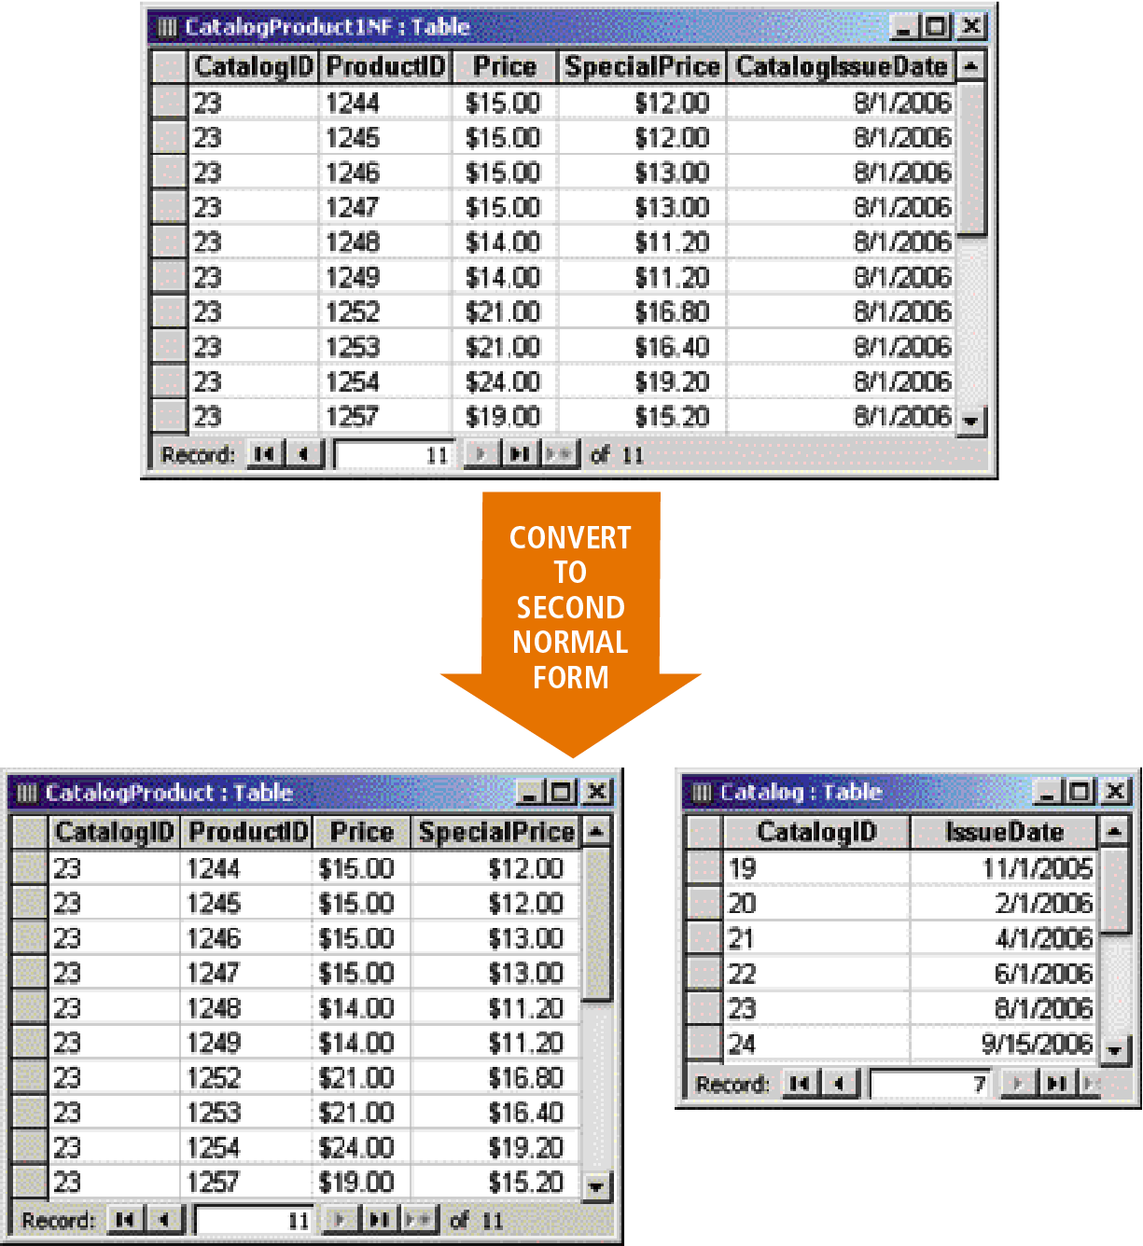
Figure 10-19
Decomposition of a first normal form table into two second normal form tables
Object-Oriented Analysis and Design with the Unified Process

Slide 38
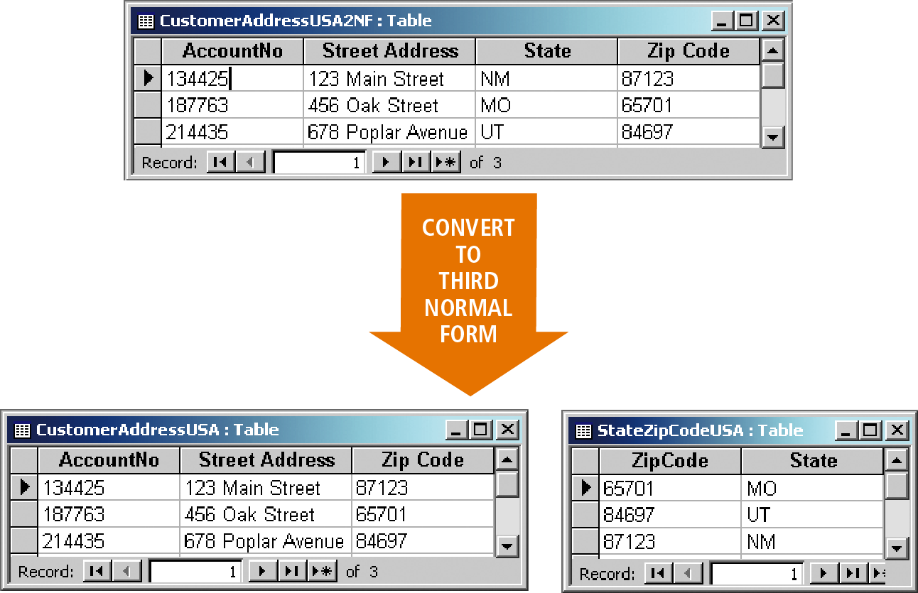
Figure 10-20
Converting a second normal form table into two third normal form tables
State is functionally dependent on ZipCode
Object-Oriented Analysis and Design with the Unified Process

Slide 39
Domain Class Modeling and Normalization
Domain class modeling and normalization are complimentary techniques
  Attributes of a class are functionally dependent on any primary key of that class
  Attributes of a many-to-many association are functionally dependent on unique identifiers of both participating classes
Tables generated from the RMO class diagram do not contain any 1NF, 2NF, or 3NF violations
Object-Oriented Analysis and Design with the Unified Process

Slide 40
Object-Relational Interaction
Hybrid object-relational databases are the most widely used approach for persistent object storage
  A relational database that stores object attributes and relationships
Object-Oriented Analysis and Design with the Unified Process

Slide 41
Object-Relational Interaction
Designing an interface between persistent classes and the RDBMS is complex
  Class methods cannot be directly stored or executed in an RDBMS
  Inheritance cannot be directly represented in an RDBMS
  New classes must be defined to store application-specific data
Object-Oriented Analysis and Design with the Unified Process

Slide 42
Data Access Classes
Data access classes implement the bridge between data stored in program objects and in a relational database
  Data access class methods encapsulate the logic needed to copy values from the problem domain objects to the database, and vice versa
    The logic is a combination of program code and embedded SQL commands
Object-Oriented Analysis and Design with the Unified Process

Slide 43
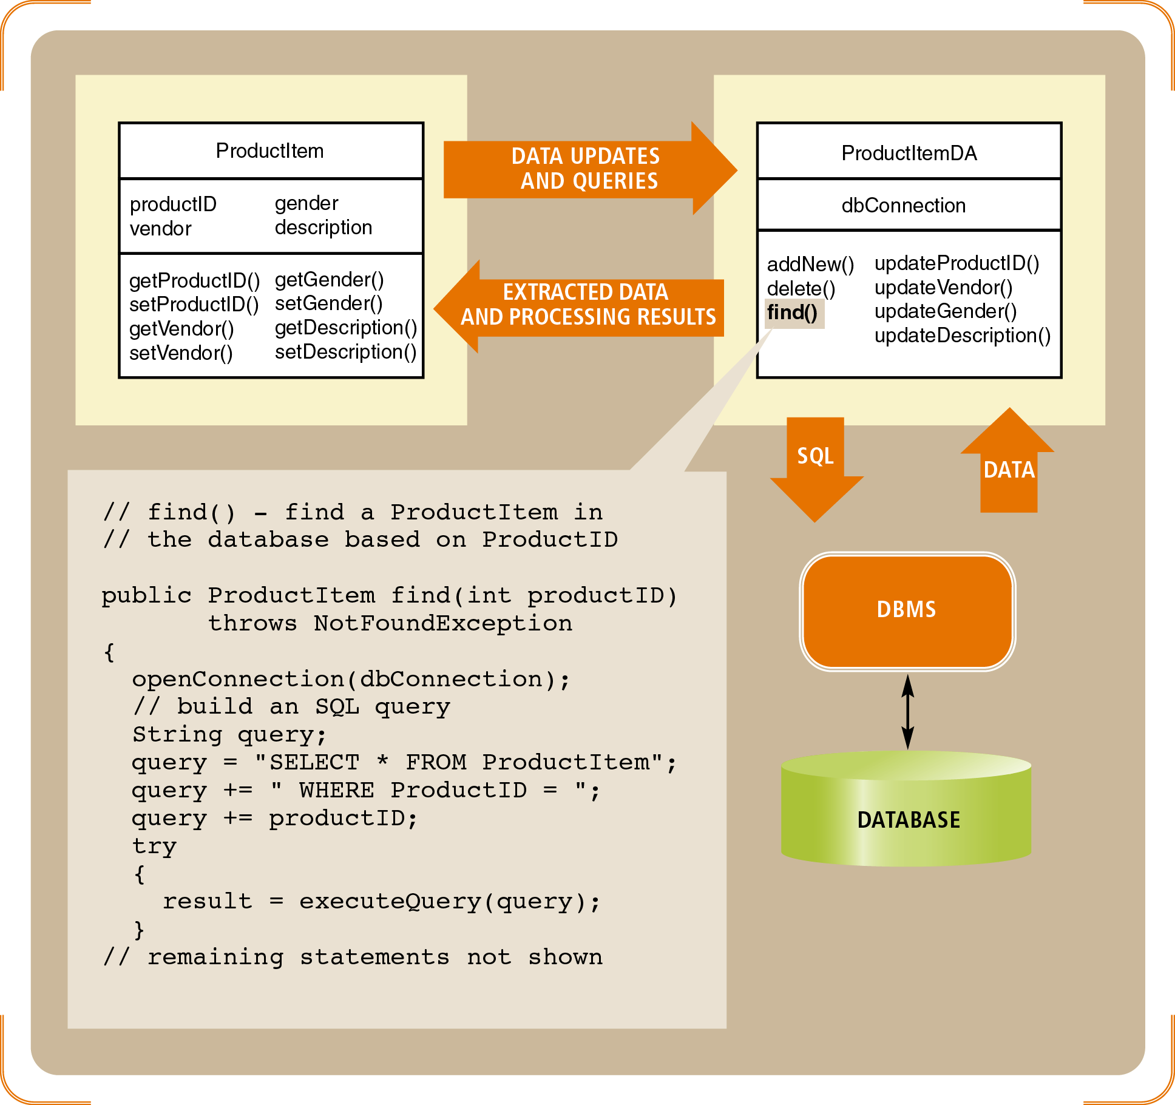
Figure 10-22
Interaction among a problem domain class, a data access class, and the DBMS
Object-Oriented Analysis and Design with the Unified Process

Slide 44
Data Types
A data type defined the storage format and allowable content of a program variable or database attribute
  Primitive data types are supported directly by computer hardware or a programming language
    i.e., integer, Boolean, memory address
  Complex data types are user or programmer defined
    i.e., date, time, currency
Object-Oriented Analysis and Design with the Unified Process

Slide 45
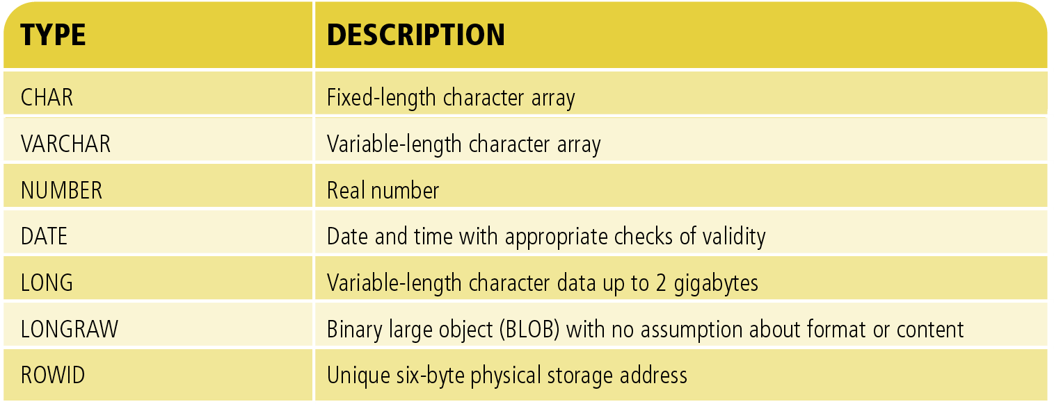
Figure 10-23
A subset of the data type available in the Oracle relational DBMS
Object-Oriented Analysis and Design with the Unified Process

Slide 46
Object DBMS Data Types
Similarities to RDBMS
  Provides a set of primitive and complex data types
  Allows a designer to define format and value constraints
Differences to RDBMS
  Allows a schema designer to define a new data type and associated constraints as a new class
    Class methods can perform many of the error- and type-checking functions
Object-Oriented Analysis and Design with the Unified Process

Slide 47
Distributed Databases
Approaches to organizing computers and other information-processing resources in a networked environment
  Single database servers
  Replicated database servers
  Partitioned database servers
  Federated database servers
  A combination of the above
Object-Oriented Analysis and Design with the Unified Process

Slide 48
Single Database Servers
Clients on more or more LANs share a single database located on a single computer system
Advantages
  Simplicity
Disadvantages
  Susceptibility to server failure
  Possible overload of the network or server
  Performance bottlenecks or propagation delays
Object-Oriented Analysis and Design with the Unified Process

Slide 49
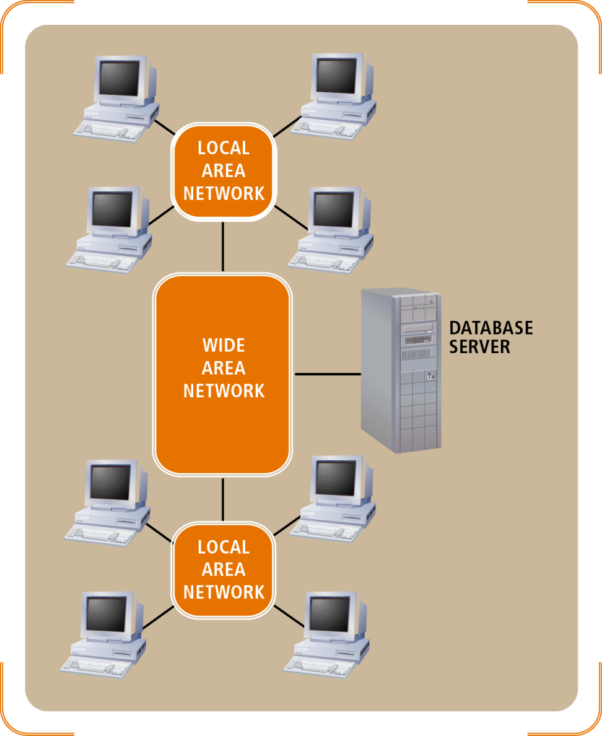
Figure 10-24
A single database server architecture
Object-Oriented Analysis and Design with the Unified Process

Slide 50
Replicated Database Servers
Clients interact with the database server on their own LAN
Each server stores a separate copy of the data
Advantages
  Fault tolerant
  Load balancing possible
Disadvantages
  Must implement database synchronization techniques
Object-Oriented Analysis and Design with the Unified Process

Slide 51
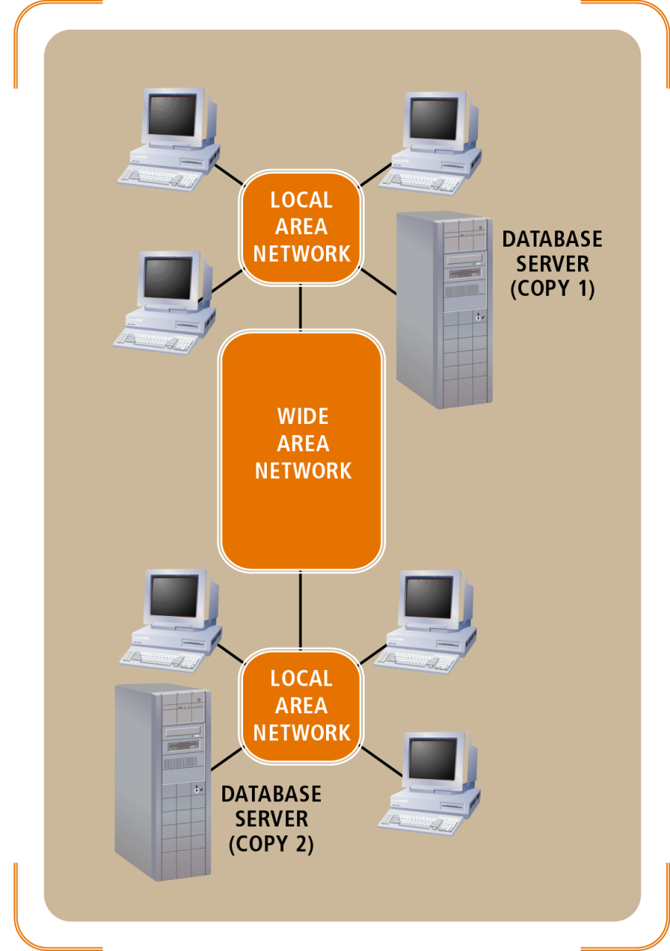
Figure 10-25
A replicated database server architecture
Object-Oriented Analysis and Design with the Unified Process

Slide 52
Partitioned Database Servers
Partitions database among multiple database servers
A different group of clients accesses each partition
Advantages
  Minimizes need for database synchronization
Disadvantages
  Schema must be cleanly partitioned among client access groups
  Members of client access group must be located in small geographic regions
Object-Oriented Analysis and Design with the Unified Process

Slide 53
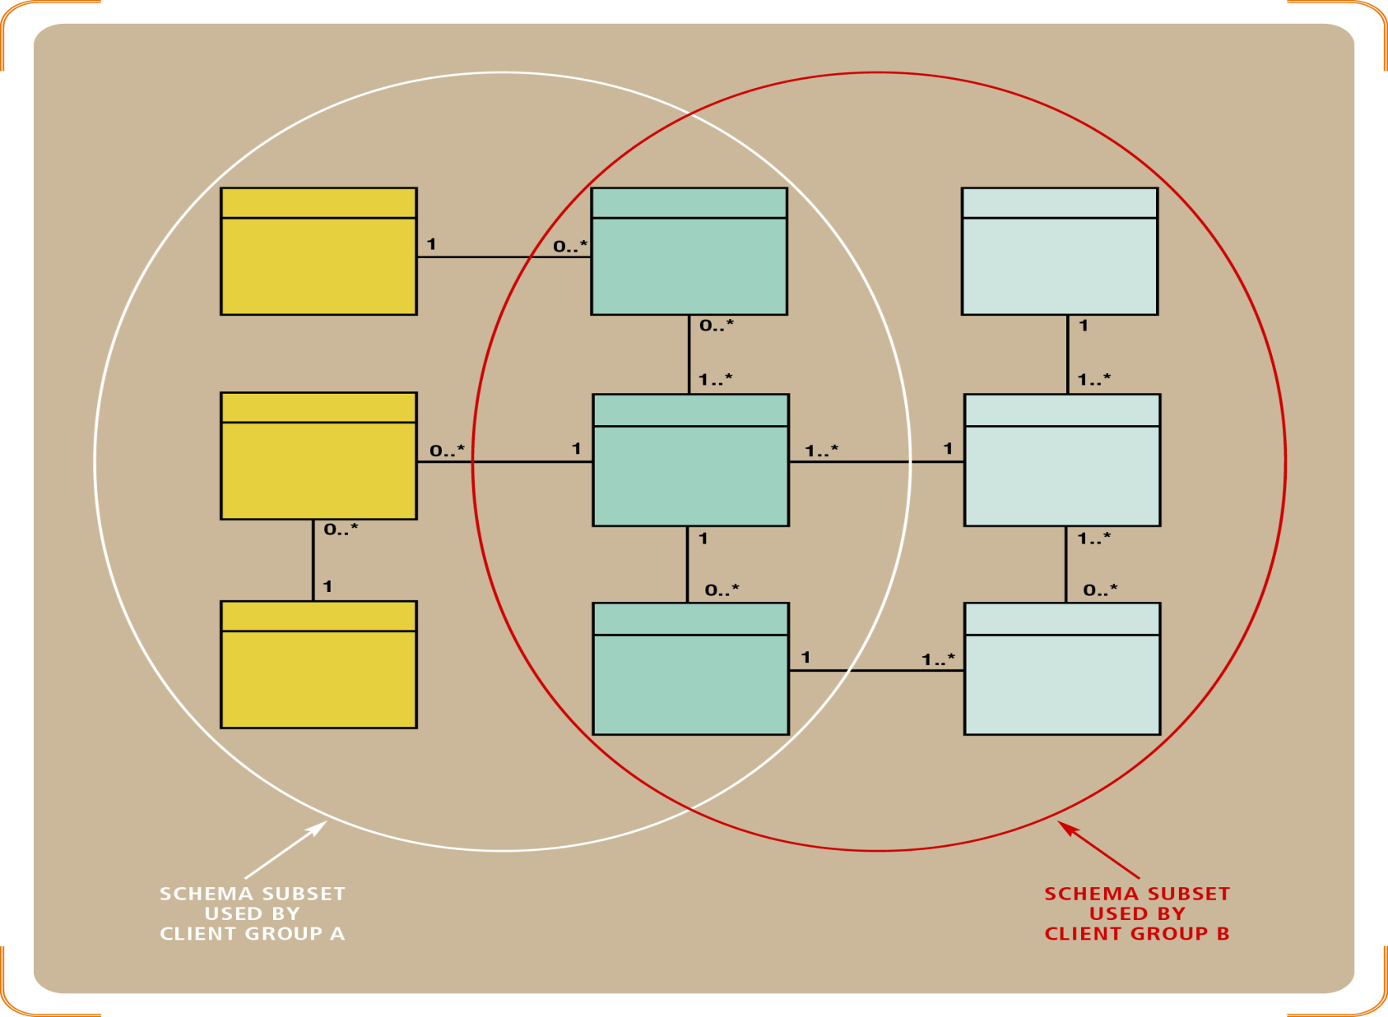
Figure 10-26
Partitioning a database schema into client access subsets
Object-Oriented Analysis and Design with the Unified Process

Slide 54
Federated Database Servers
Used to access data stored on incompatible storage models or DBMSs
A combined database server acts an intermediary, sending requests to underlying database servers
Advantages
  Only feasible approach for implementing data warehouses
Disadvantages
  Extremely complex
Object-Oriented Analysis and Design with the Unified Process

Slide 55
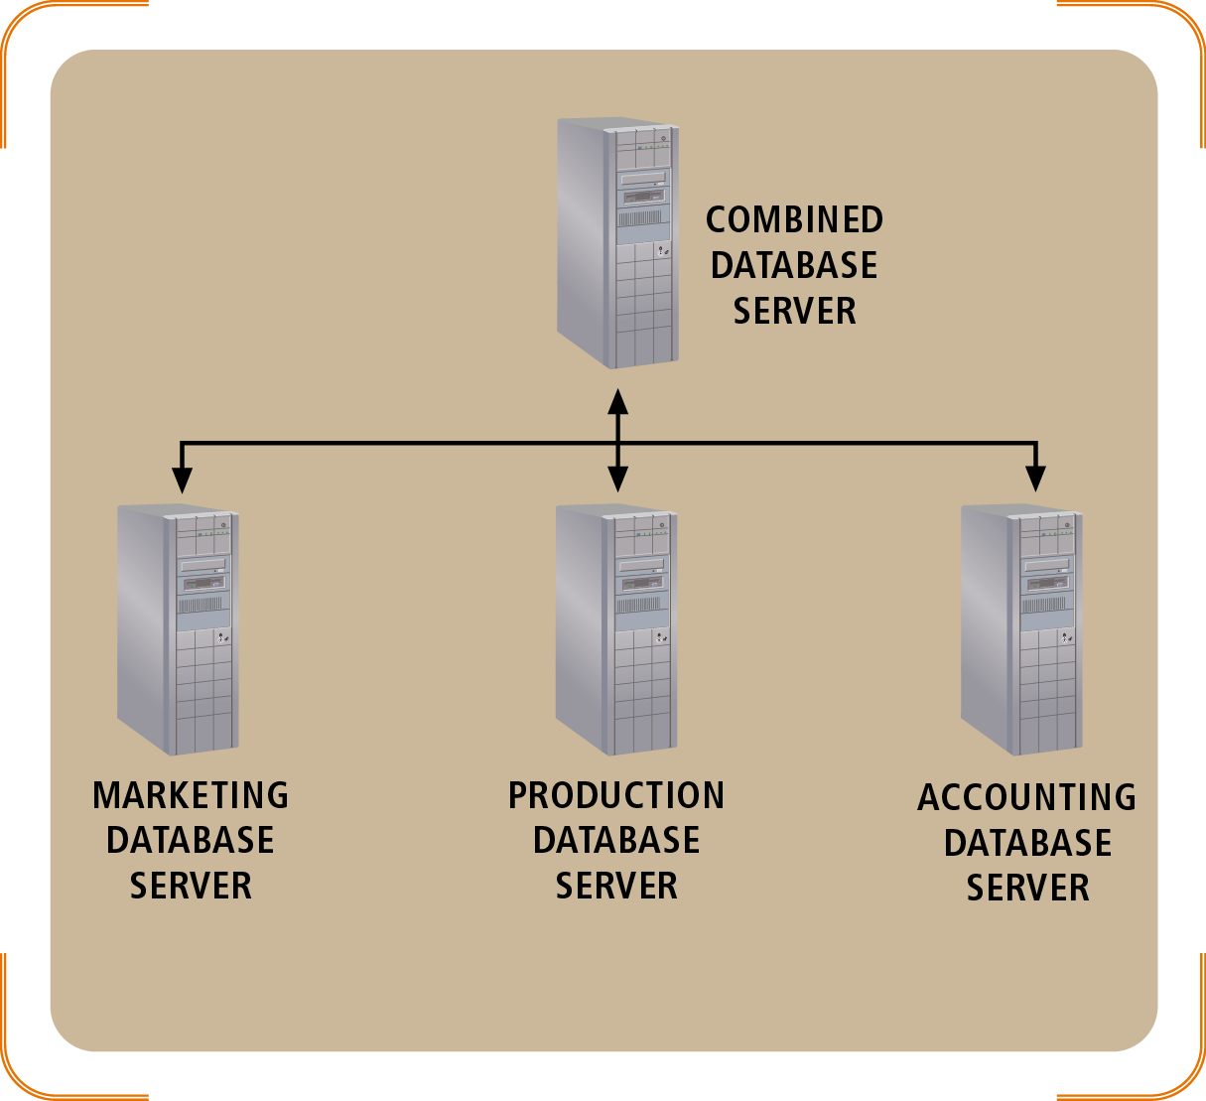
Figure 10-28
A federated database server architecture
Object-Oriented Analysis and Design with the Unified Process

Slide 56
RMO Distributed Database Architecture
Two possible approaches
  Single server architecture
    Simple to implement, but high WAN requirements and risk of server failure
  Combination of partitioning and replication
    Reduced fault tolerance and WAN requirements, but need for additional database servers and synchronization techniques
Decision based on analysis of cost and desired system performance
Object-Oriented Analysis and Design with the Unified Process

Slide 57
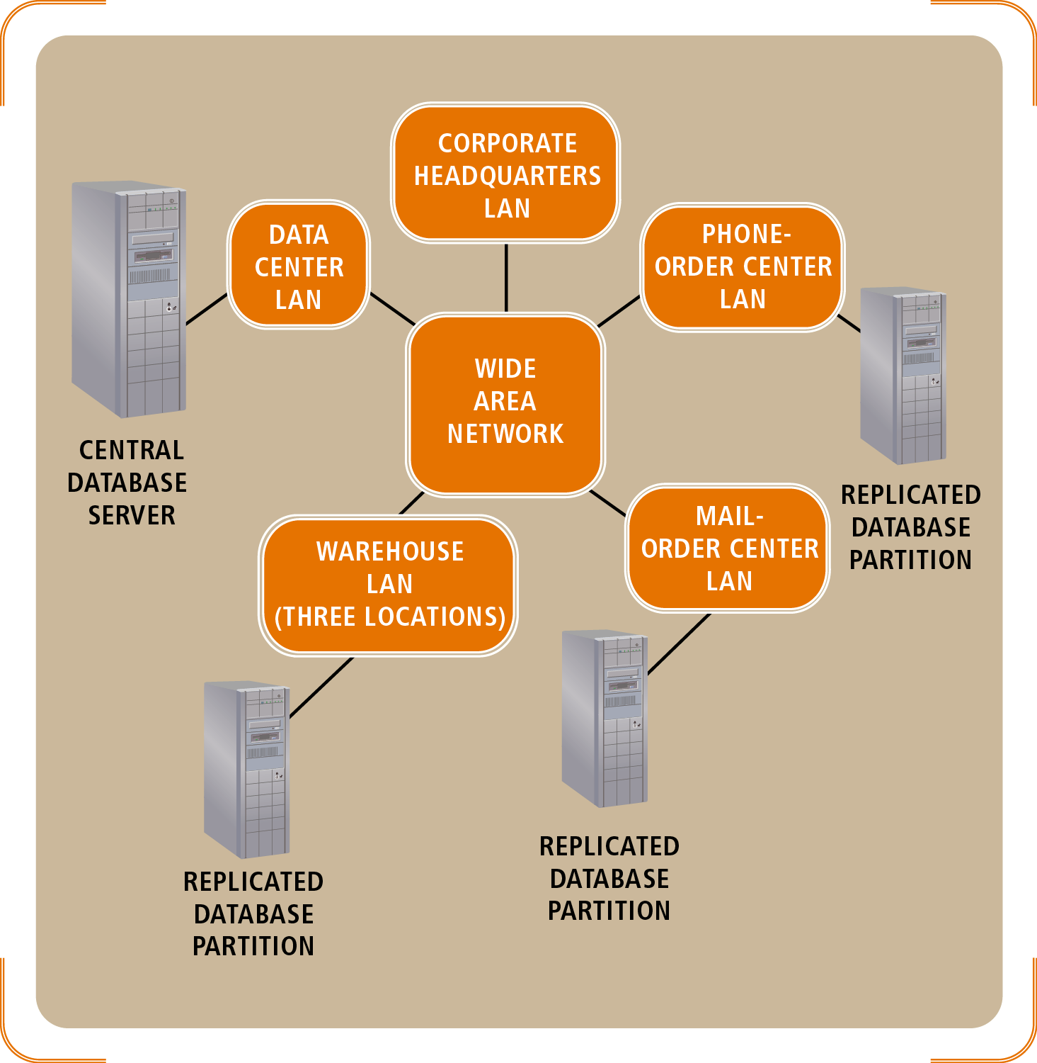
Figure 10-30
A replicated and partitioned database server architecture for RMO
Object-Oriented Analysis and Design with the Unified Process

Slide 58
Database Design Within the UP
Primary factors for when and how to perform database design
  Architecture
    Integrate database design with network design, Web component services, and security decisions
  Existing databases
    Accommodate preexisting constraints
  Domain class diagram
    Related parts must be developed before database design
Object-Oriented Analysis and Design with the Unified Process

Slide 59
Summary
One of the key activities in design is developing a relational or object database schema
  Schemas are developed from class diagrams
  An object database stores data as a collection of related objects
    Associations are represented by storing unique object identifiers in related objects
  A relational database stores data in tables
    Associations are represented with foreign keys
Object-Oriented Analysis and Design with the Unified Process

Slide 60
Summary (continued)
Architecture for multiple databases
  Replicated
    Multiple copies on different servers
  Partitioned
    Partial copies placed in proximity to user subsets
  Federated
    Multiple databases with a DBMS single point of access
Database design should be performed in an early iteration to minimize risk
Object-Oriented Analysis and Design with the Unified Process

